Slide 1
Strengthening Democracy: Challenges and Solutions
Ankith SR
Adith Sagar Gowda

Slide 2
PROBLEM STATEMENT
Any electoral party, would be in a state of apprehension right before the ection results are out. During such times the first view that one approaches is the social media. Since word spreads faster in today’s world of technology, it is evident that one would turn to the most widespread platform in the world. Analysing metrices using social media platforms is quite hectic due to the rapid turnaround of information. This concern is widespread among the majority of political parties and is a common worry shared by any candidate running for election.
This is the very issue that we aim to tackle, along with other issues that revolve around addressing the prevalent challenges faced by political parties and candidates during election periods. Our goal is to find effective solutions to enhance their public perception, engage with voters, and overcome the hurdles that hinder their success in the democratic process. By focusing on this issue, we seek to empower political entities and candidates to strengthen their position, build trust with the electorate, and foster a more vibrant and inclusive democratic landscape.

Slide 3
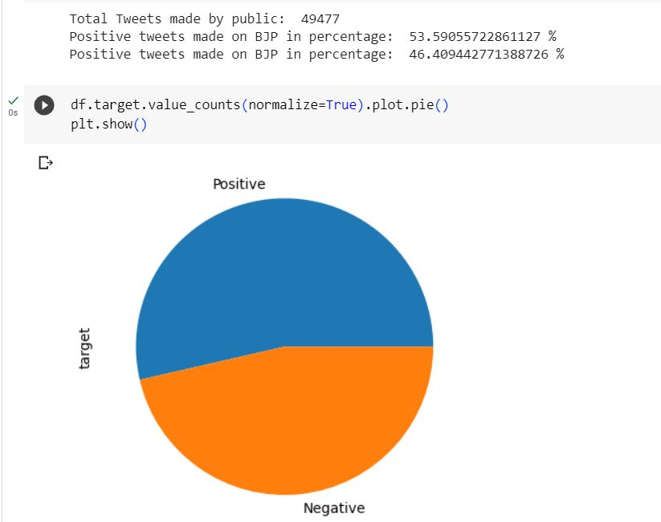
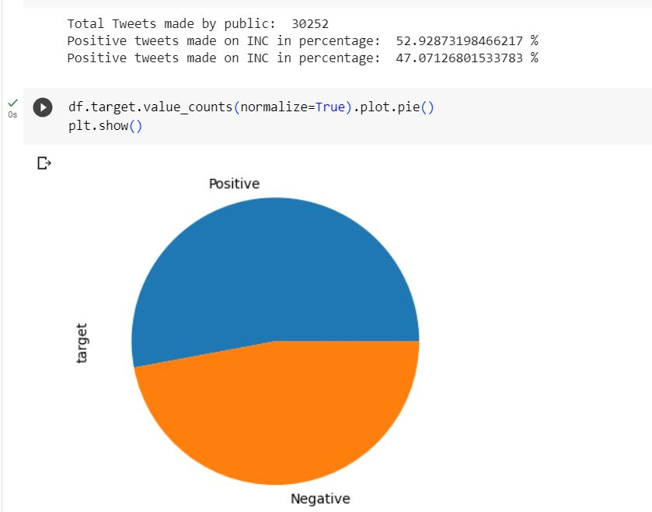
Our approach
So what we are basically trying to do is, create a Machine Learning model which can take a certain post/comment and predict its demographic along with its positivity or negativity with respect to the party. The model itself is trained based on the electoral tweets of 2019, within a certain time period right before the results of the election. This gives the worst case scenario for the model to be tested, the model is based on the SVM algorithm and the Naïve Bayes Algorithm for Sentiment Analysis. The model also involves visualization which gives the demographic for each and every party, down to the region and count of votes for the both men and women.

Slide 4
ML MODEL
https://www.kaggle.com/datasets/parthdevrani/bjp-vs-congress-tweets?select=congress_tweets.csv
This is the link for the dataset related to the Sentiment analysis.
https://www.kaggle.com/datasets/awadhi123/indian-election-dataset
This dataset is mainly used for the analysis of demographics
As the name Sentiment suggests, the model trained on the two algorithms mentioned are to mainly asses the sentiment of a group/region towards a particular subject.
As for the visualization of the trained model we use a package provided by Python libraries, knowns as Gradio.
Gradio is a Python package. It is an open-source library that you can install and use in your Python environment. Gradio allows you to turn your machine learning models into user-friendly web apps without much coding. It supports various input types like text, images, and audio, and it displays model predictions on a web interface. With Gradio, you can easily share and deploy your models so that anyone can interact with them through a web browser without needing to know how to run Python code.
NOTE: In order to access the UI, you will need to run the entire ML Model or it can be accessed through the senti.pkl file.
Optional: https://9d82450f526b6f48da.gradio.live/ - Congress
https://e98d4b501bc6a666a4.gradio.live/ - BJP

Slide 5
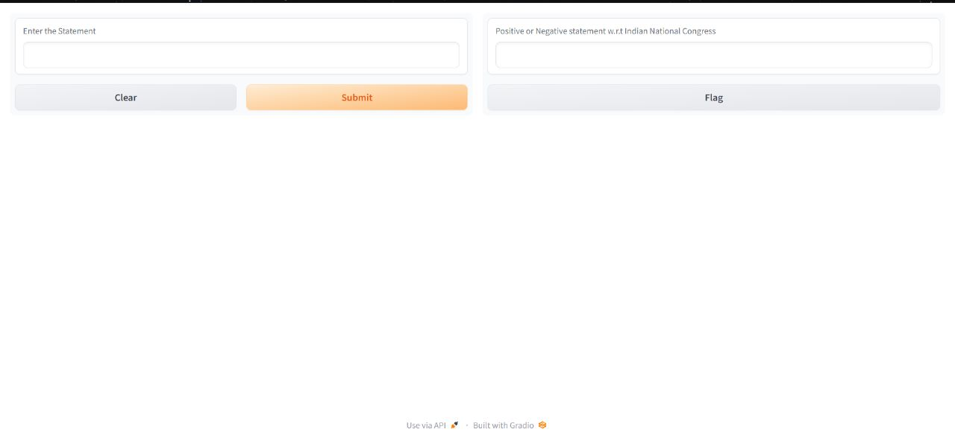
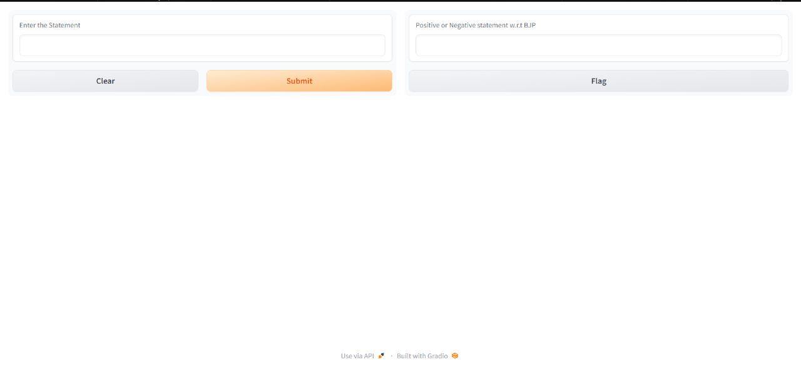

Slide 6
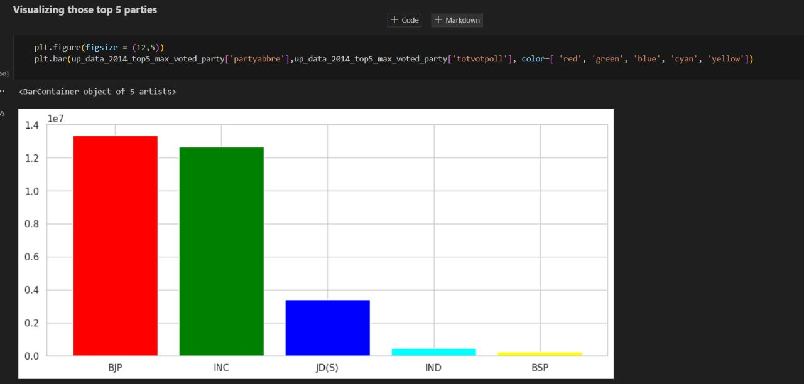
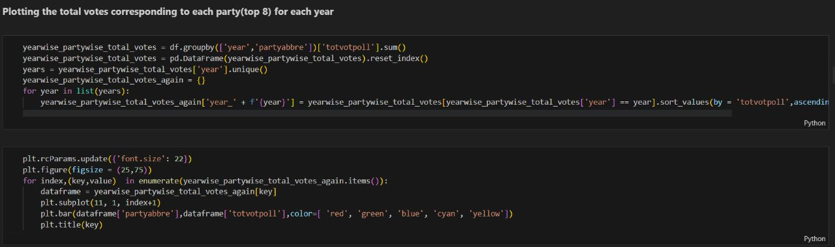
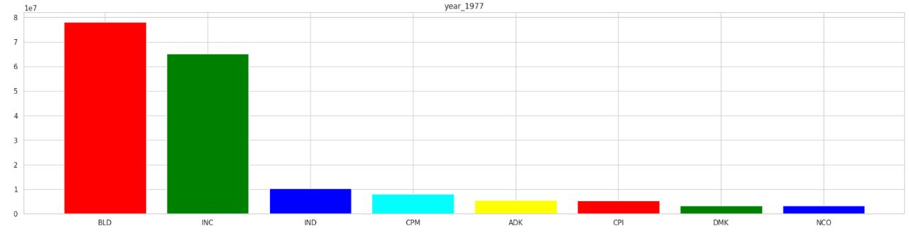
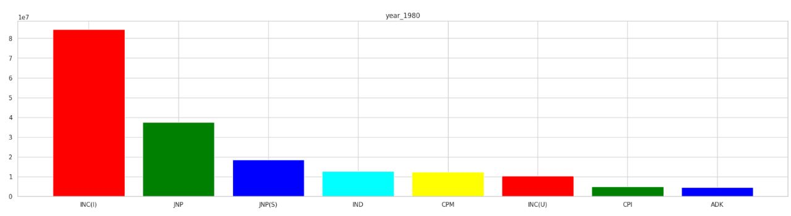
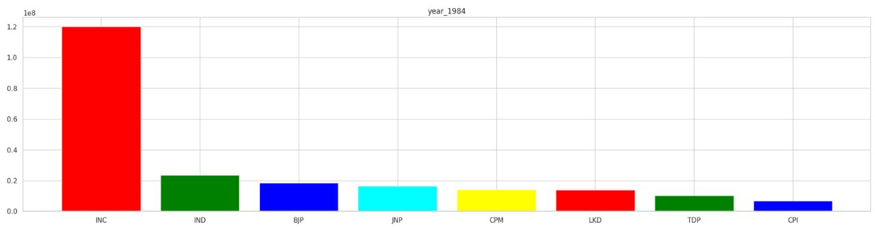
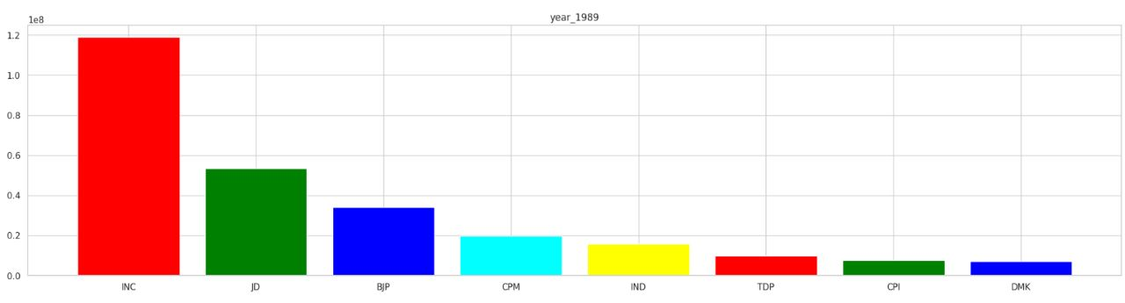
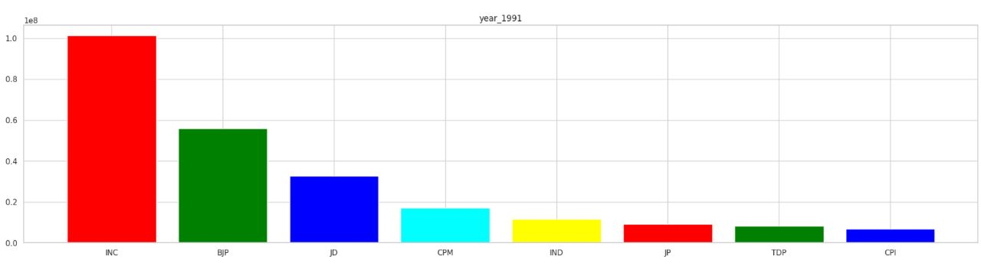
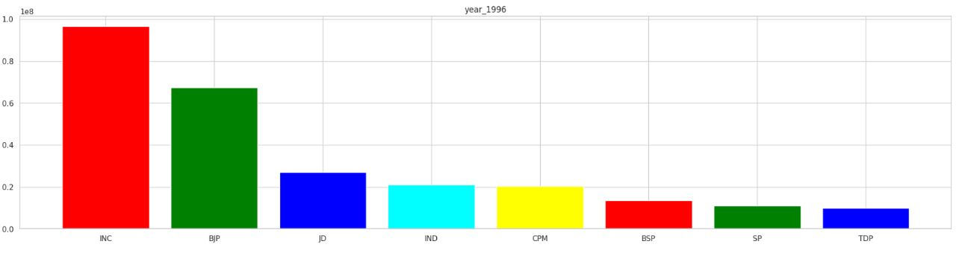
Visualization of demographics

Slide 7
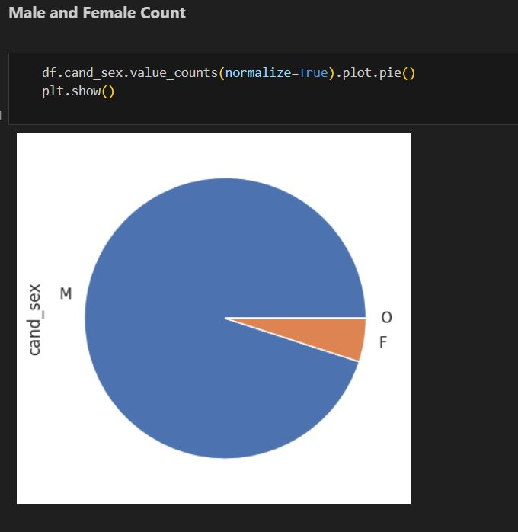
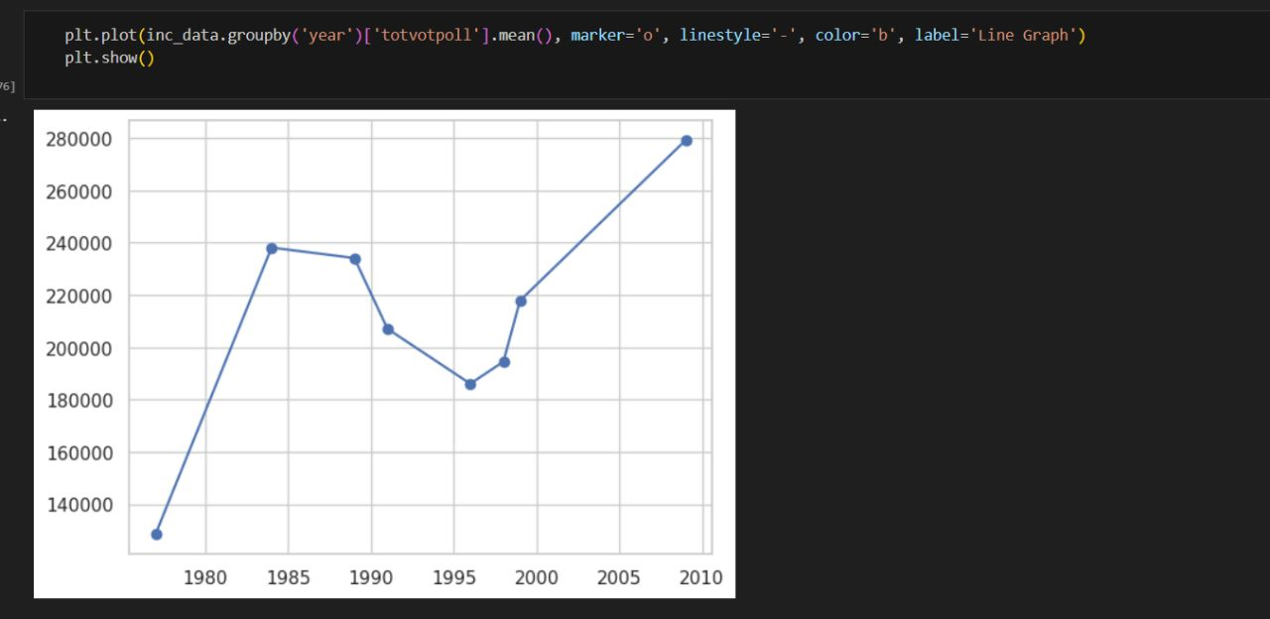
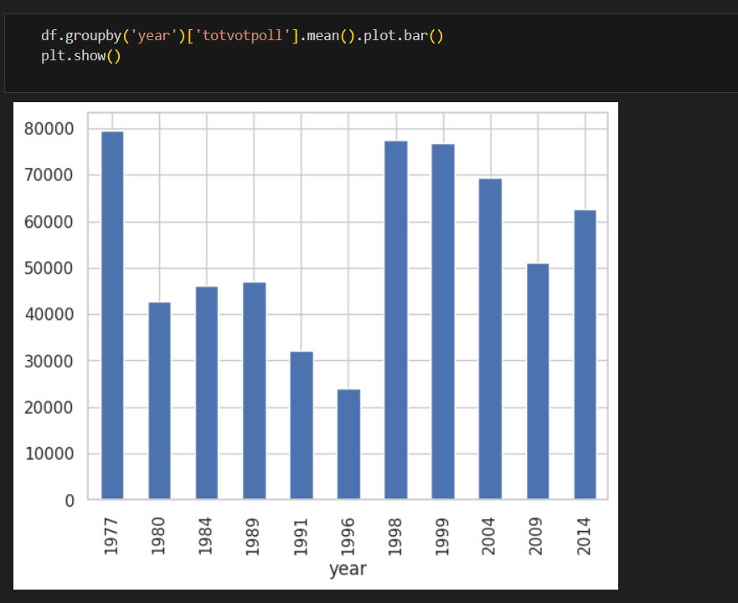
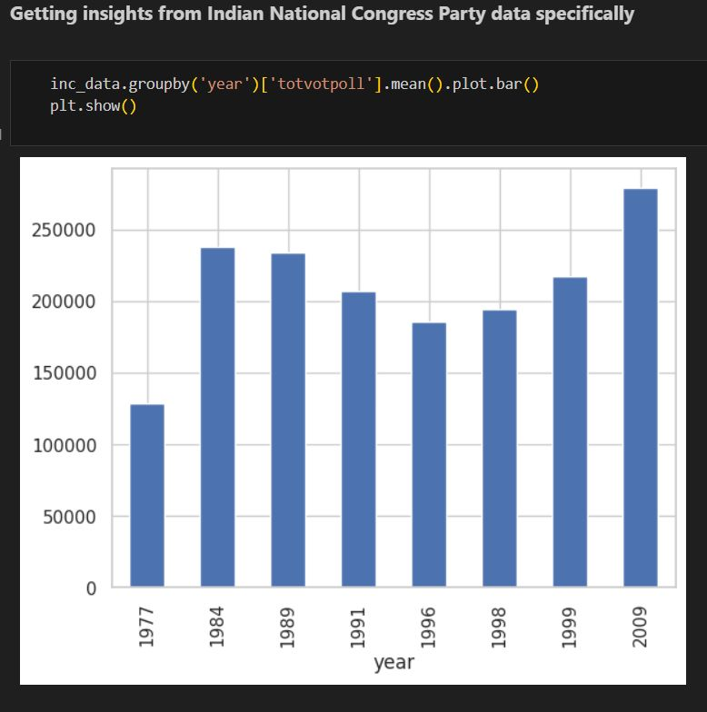
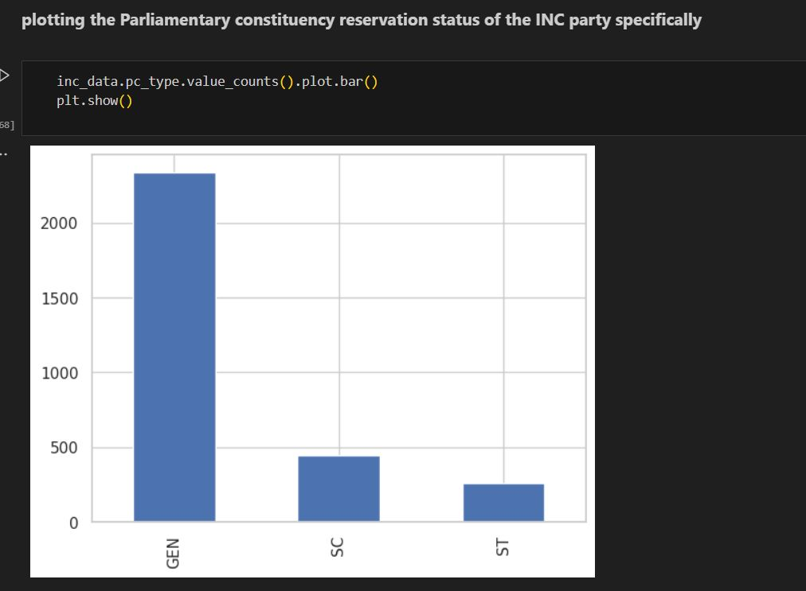
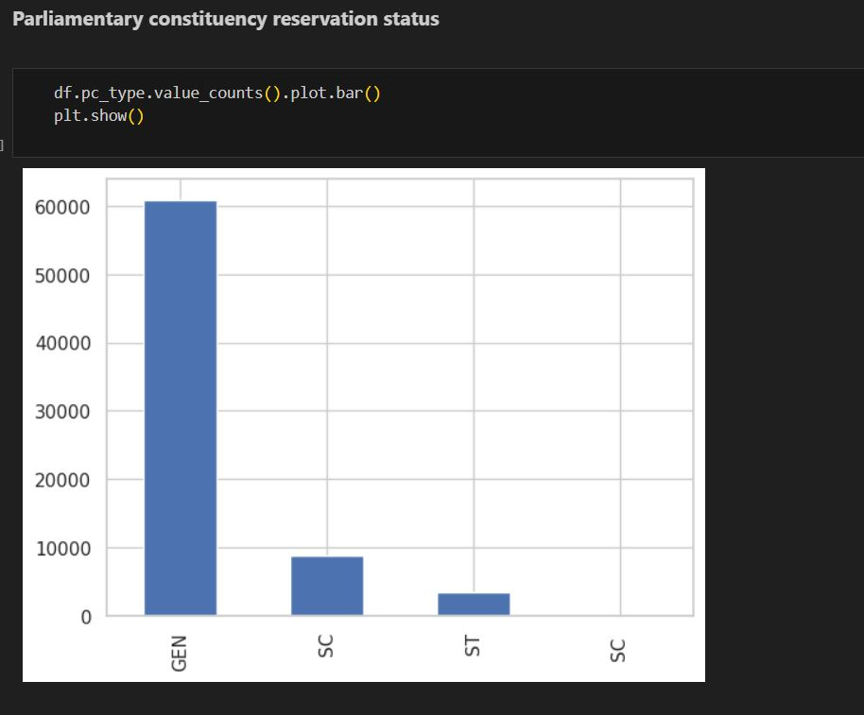
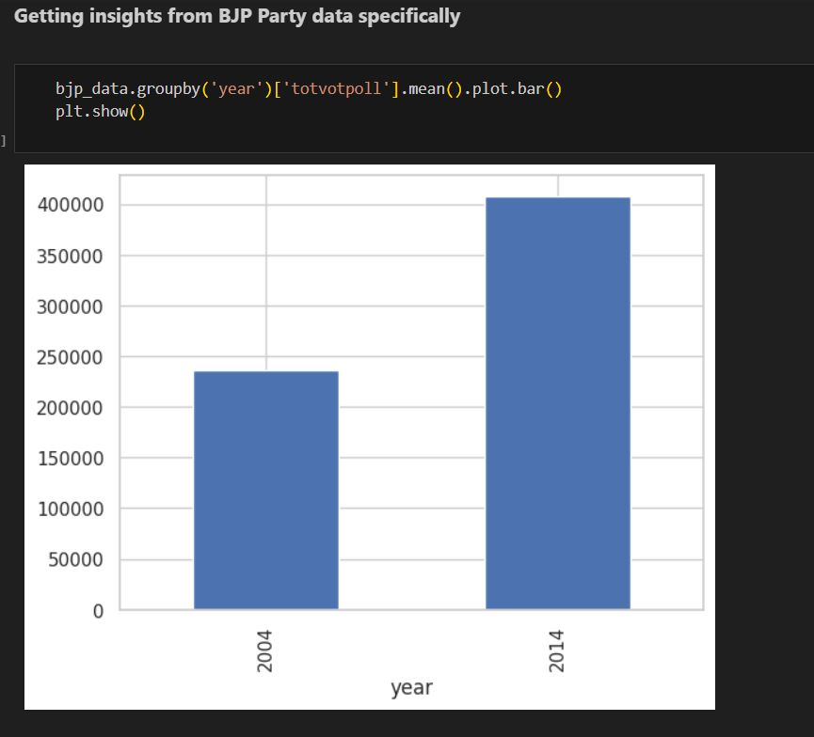
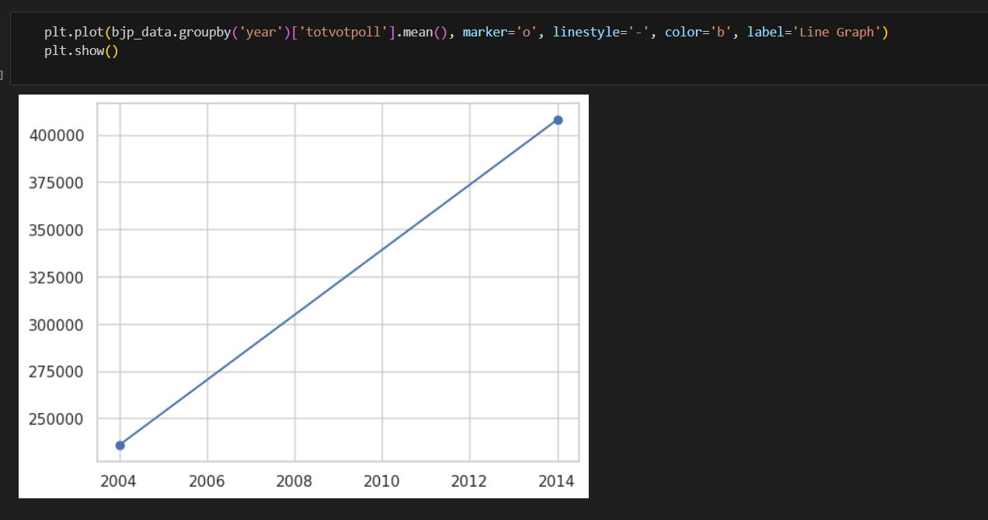
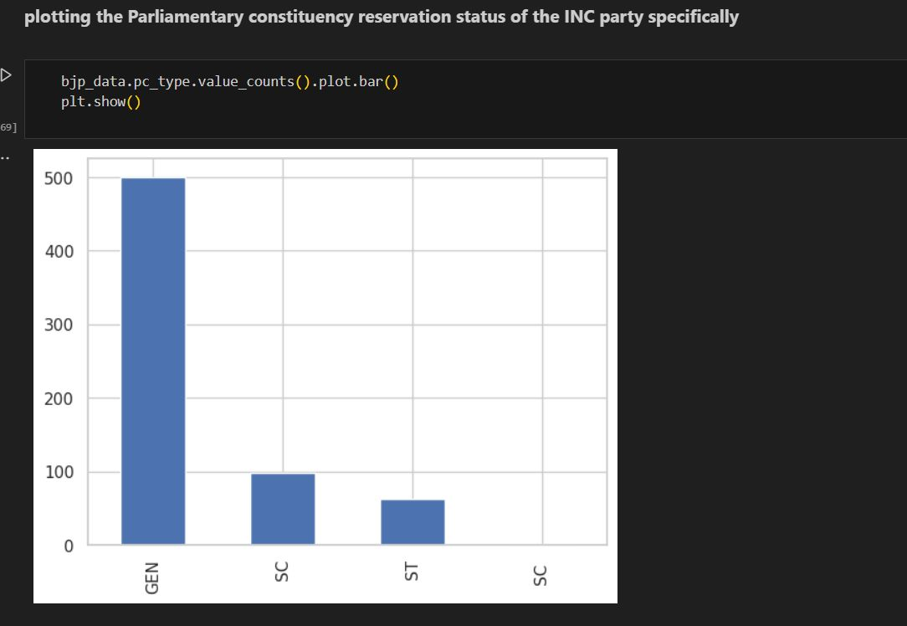

Slide 8
Enhancement
The Model can be further improved by implementing Convolution Nueral Networks algorithm in order to improve the accuracy. It can also implemented to include larger datasets and extract the data on its own by using the API’s of certain social handles.
Another thing which can be noted as well is the columns set in the data set, right now we are using a fairly simple data set which gives us the necessary. However, this can be further improved by extracting certain data. For example, is there is a tweet been sent (Pro Congresss), we will need additional information such as the number of retweets, comments, likes and the username of the person who as tweeted the original. This will give us a better understanding of the tweet itself, and also improve the training of the model.

Slide 9
Practical uses of the Product

Slide 10
Party status across regions
Under enhancement we had mentioned a few points regarding the improvement of the product. In which one of the main points was including a counter, to keep track of the number of positive as well as negative remarks regarding the party. Once this counter is implemented the data set can also be further improvised to short list data based on age and region. This gives the party an opportunity to analyse how they are performing/view stands on certain age groups.
Which will allow the party to understand their drawbacks and where they currently stand. The model can be modified for different age groups, gender based classification is another level of enhancement.
The party will highly benefit from there analysis models, due to the above mentioned details.

Slide 11
Internal party members
There are certain things that can be analyzed among the party members, which are as follows:
Identify loyal supporters and engaged members who actively advocate for the party's interests.
Detect dissent and internal divisions, helping leaders address concerns and maintain party unity.
Evaluate leadership support and influence, identifying key influencers within the party.
Track reactions to policy proposals and manifestos to fine-tune policies according to member preferences.
Gather feedback for improvement and measure member satisfaction with the party's performance and direction.
Segment members based on attitudes and preferences, enabling targeted communication and engagement strategies.
Assist in crisis management and real-time response during challenging situations.

Slide 12
Concentration of Power
Concentration of power can mean two things, one is that the party has genuinely gained the trust of the people in a certain region over time. However, on the other hand it can also mean that the specific party has been involving in malpractices with respect to the elections.
This is where the sentiment analysis can be implemented on larger scale to test the demographic regarding that particular region, so supposing the analysis suggests that there is much higher negative feedback on the party (the one with concentration of power), it could be an indication of malpractice being involved in the electoral procedure.
This gives an opportunity for the opposing party to pressurize the ruing party (party in power) that has been using unethical methods for their reign.

Slide 13
THANK YOU

